Slide 1




#10 SWISS repositories (SWISSUbase – Taking Quality to the Next Level)
Rita Gautschy (DaSCH), Guillaume Lefebvre (FORS), Daniela Subotic (DaSCH), Bojana Tasic (FORS)

Slide 2
Benefits
An overview of all repositories with their maturity level that will help researchers to find the best repository for their needs
Receive feedback from researchers what are the most important points for deciding for or against a repository
Help repositories to see where they stand in comparison to the expectations from the research community and in which direction to further develop
Make the process of evaluation of repositories more transparent to the research community

Slide 3
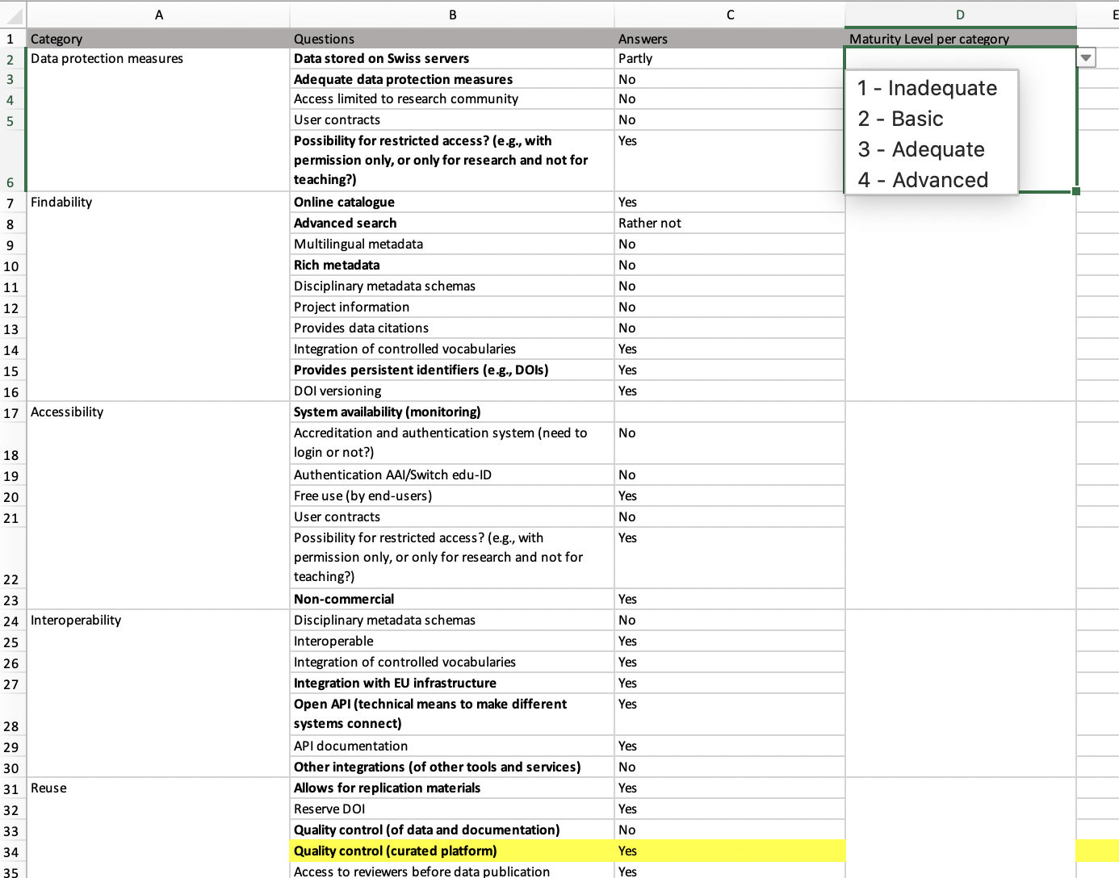
How it started…

Slide 4
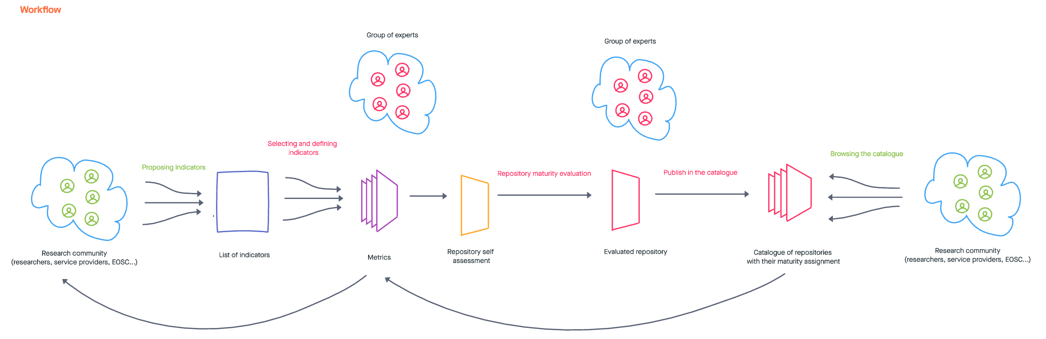
Workflow

Slide 5
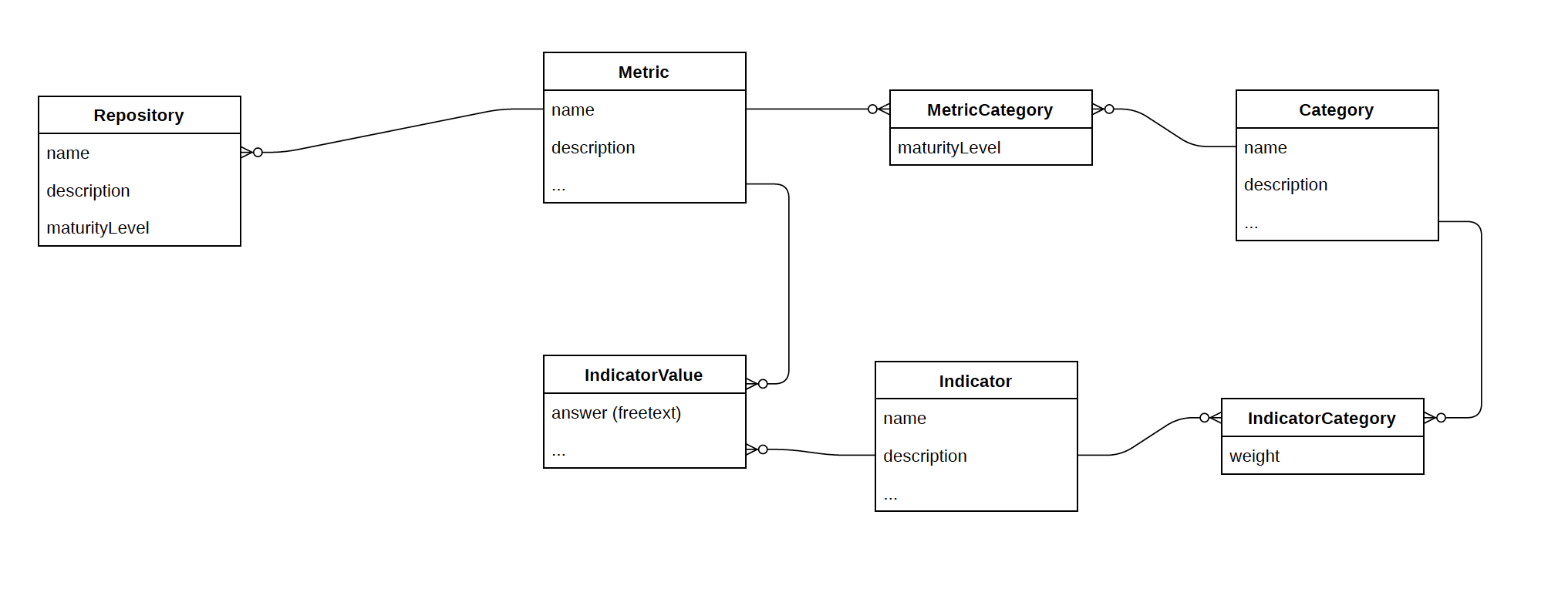
Data model

Slide 6
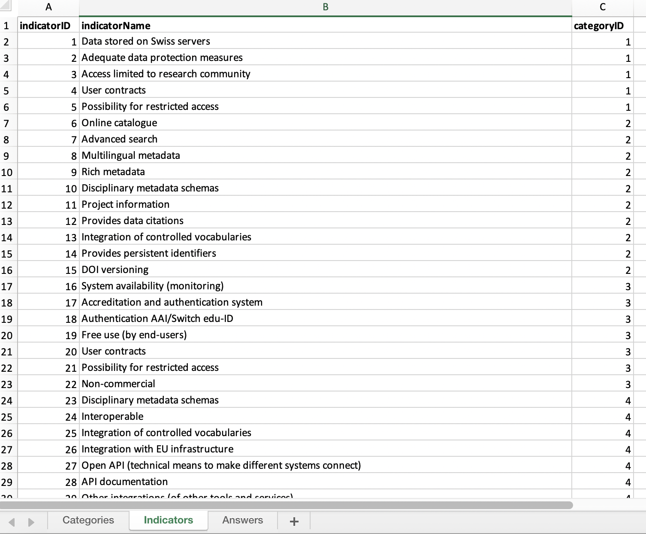
Metrics

Slide 7
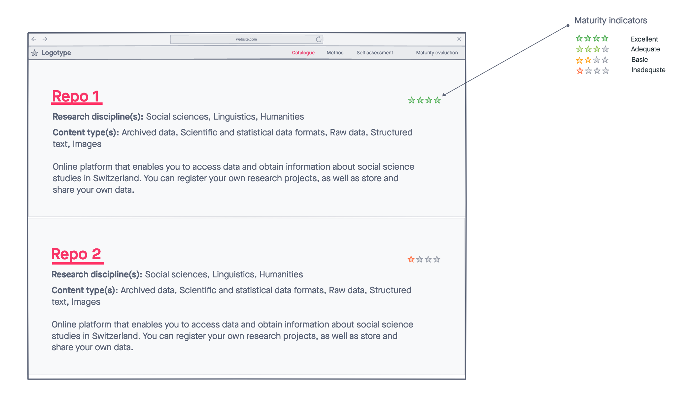
Mockups: Catalogue

Slide 8
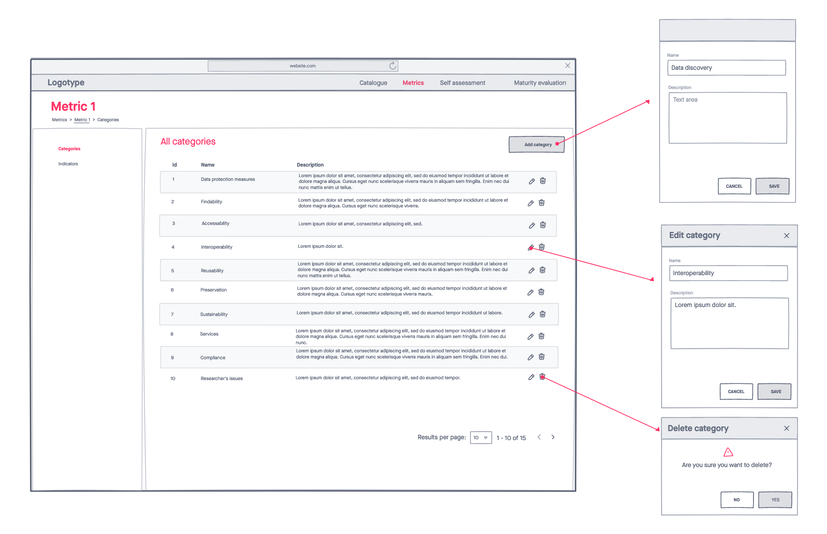
Mockups: Metrics – Categories

Slide 9
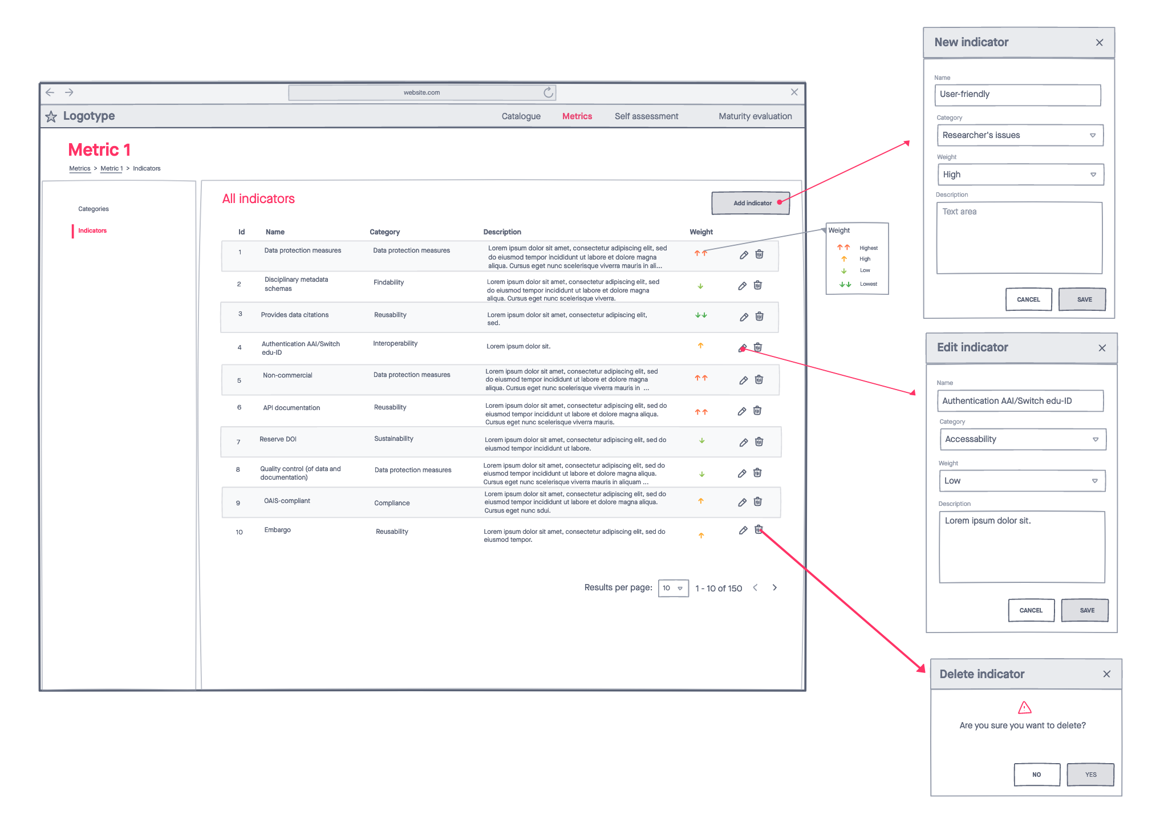
Mockups: Metrics – Indicators

Slide 10
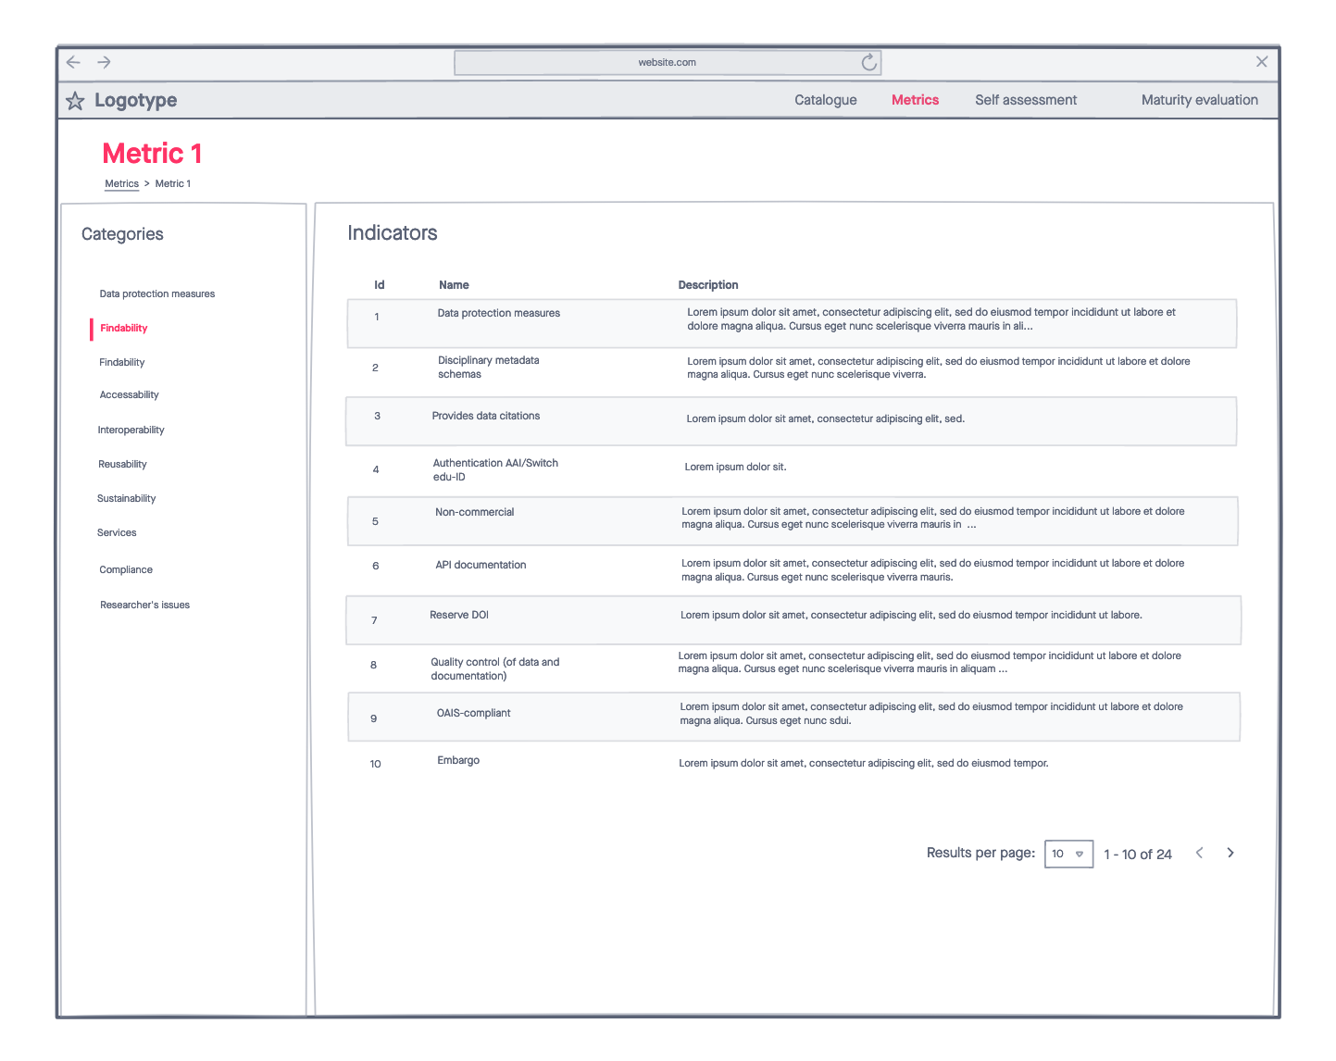
Mockups: Metrics – Metric 1

Slide 11
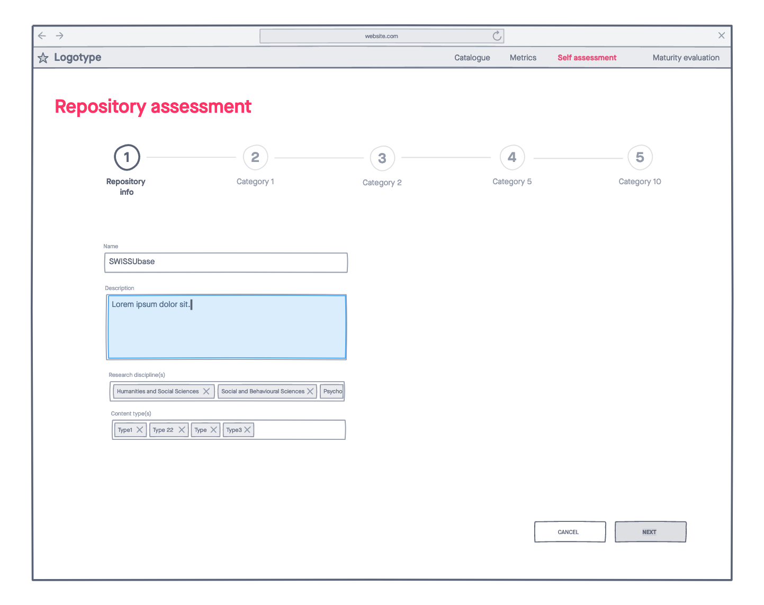
Mockups: Self assessment – Step 1

Slide 12
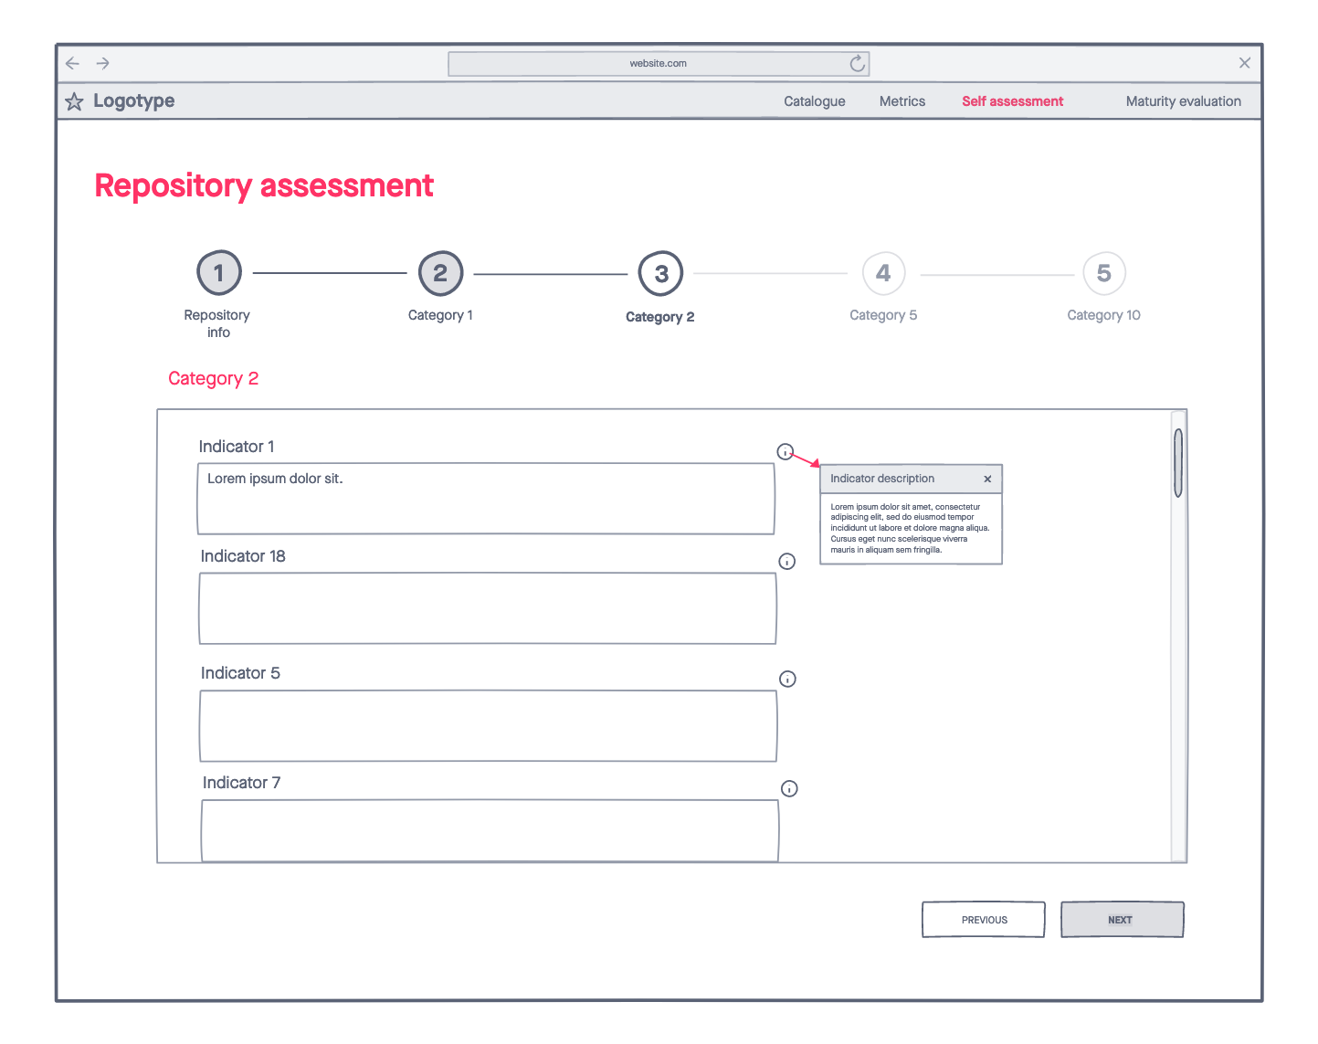
Mockups: Self assessment – Step 2

Slide 13
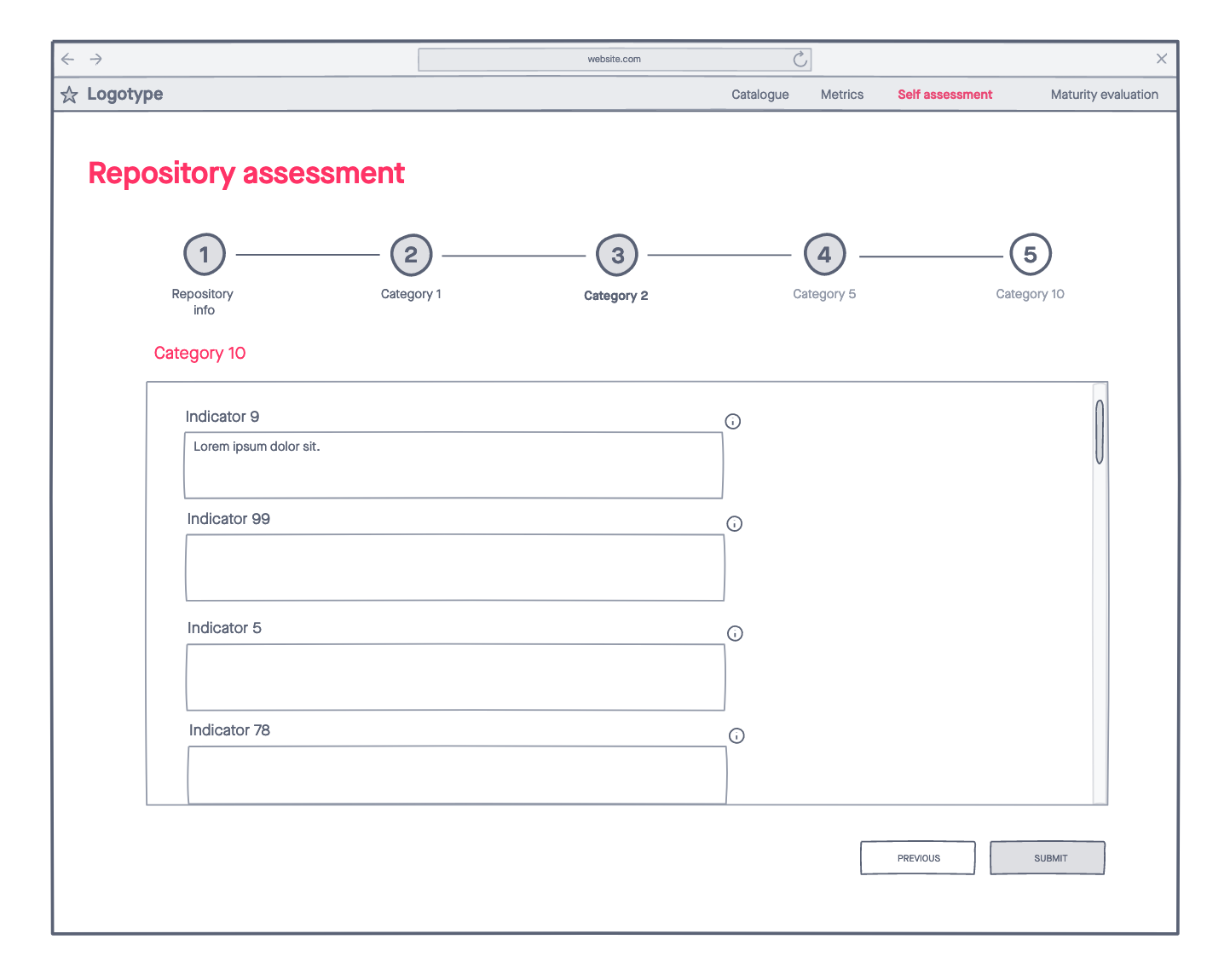
Mockups: Self assessment – Final step

Slide 14
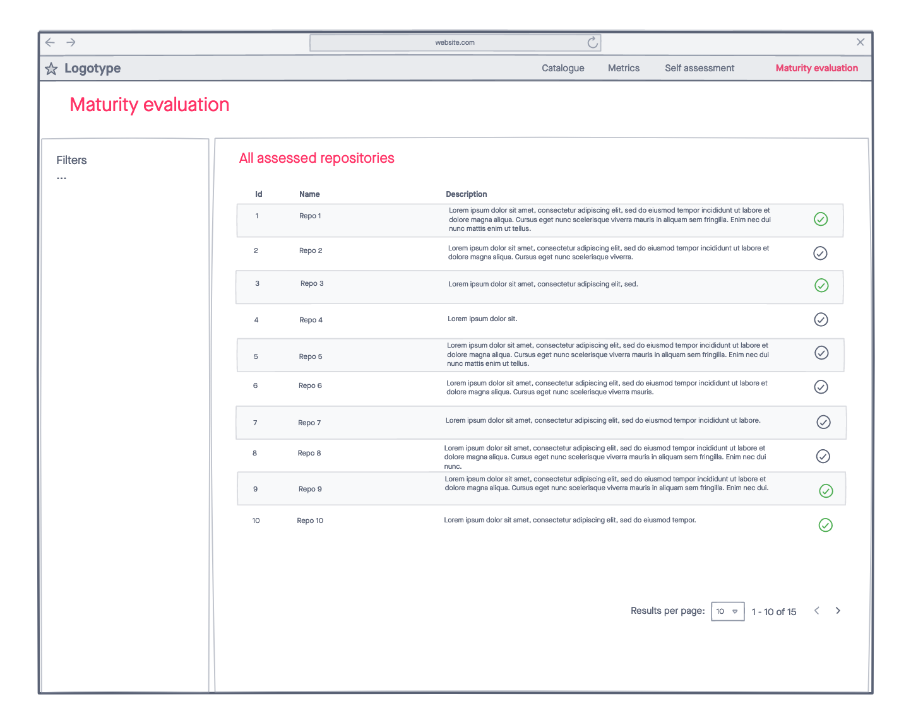
Mockups: Maturity evaluation

Slide 15
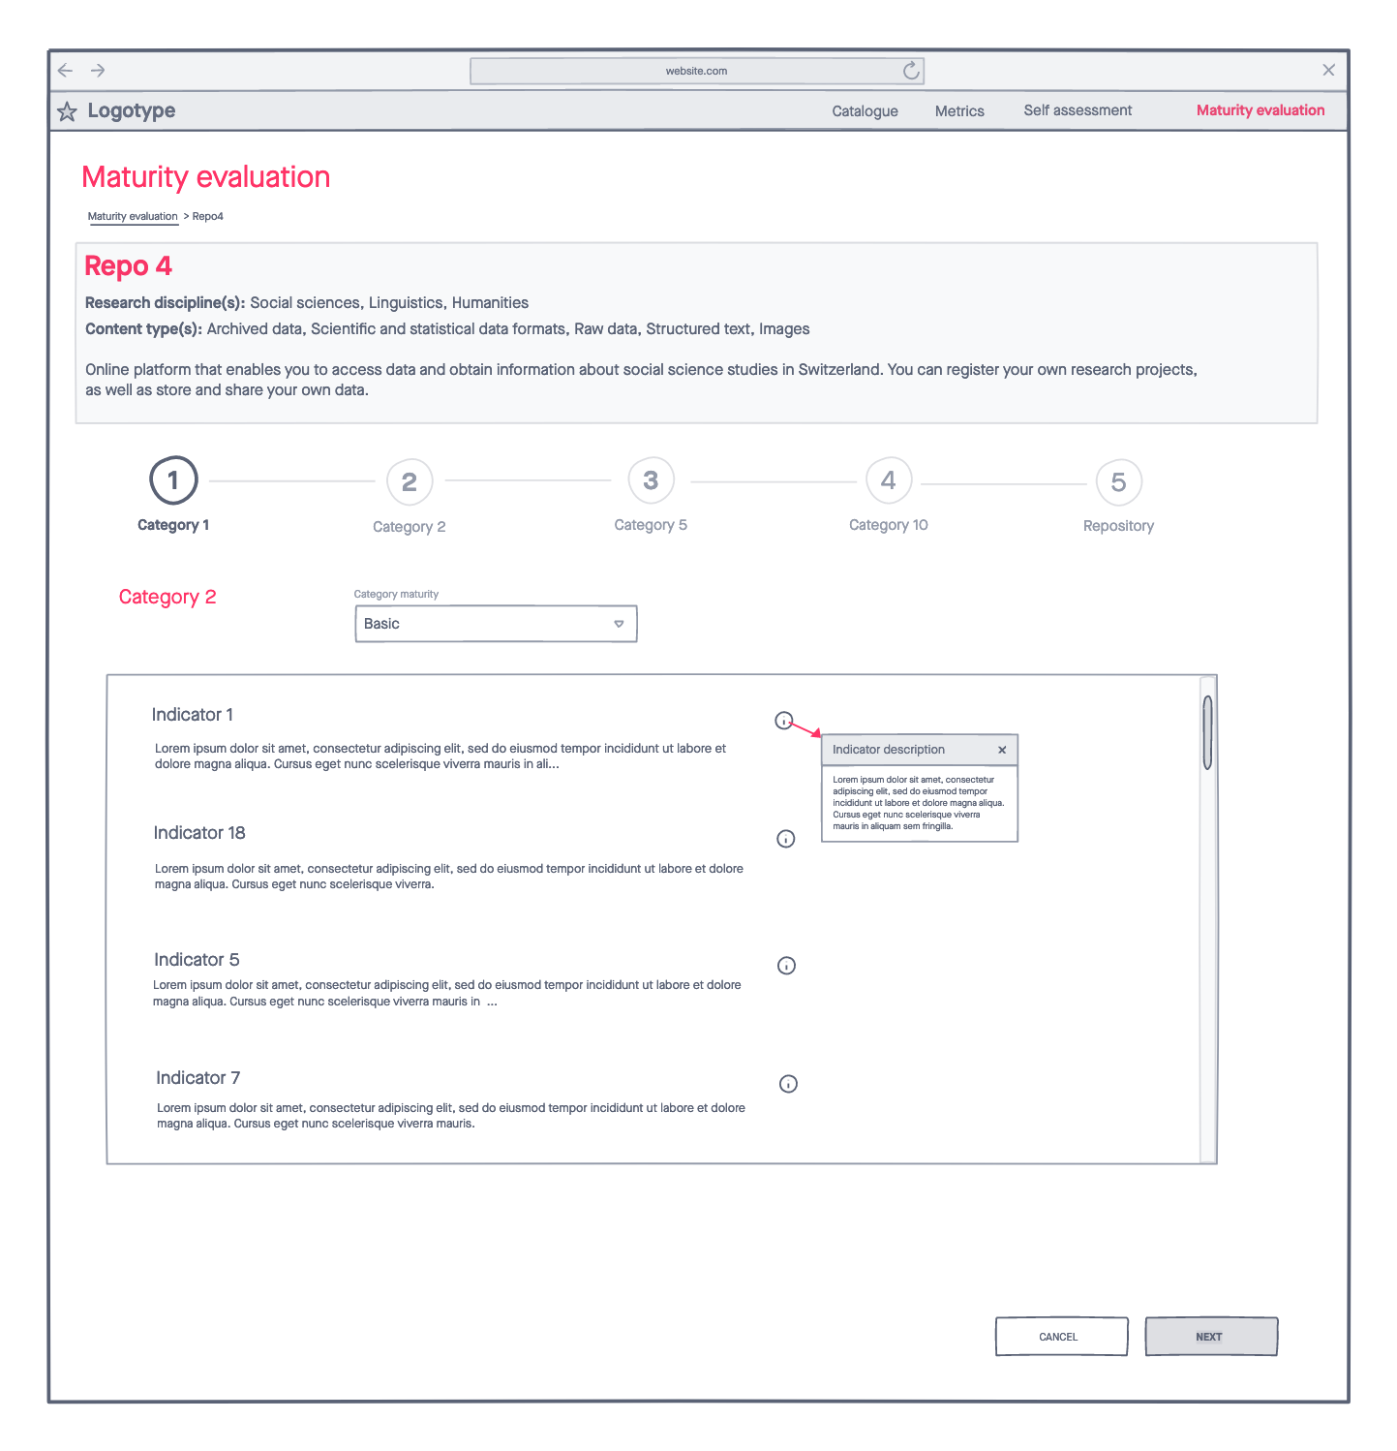
Mockups: Maturity evaluation – Step 1

Slide 16
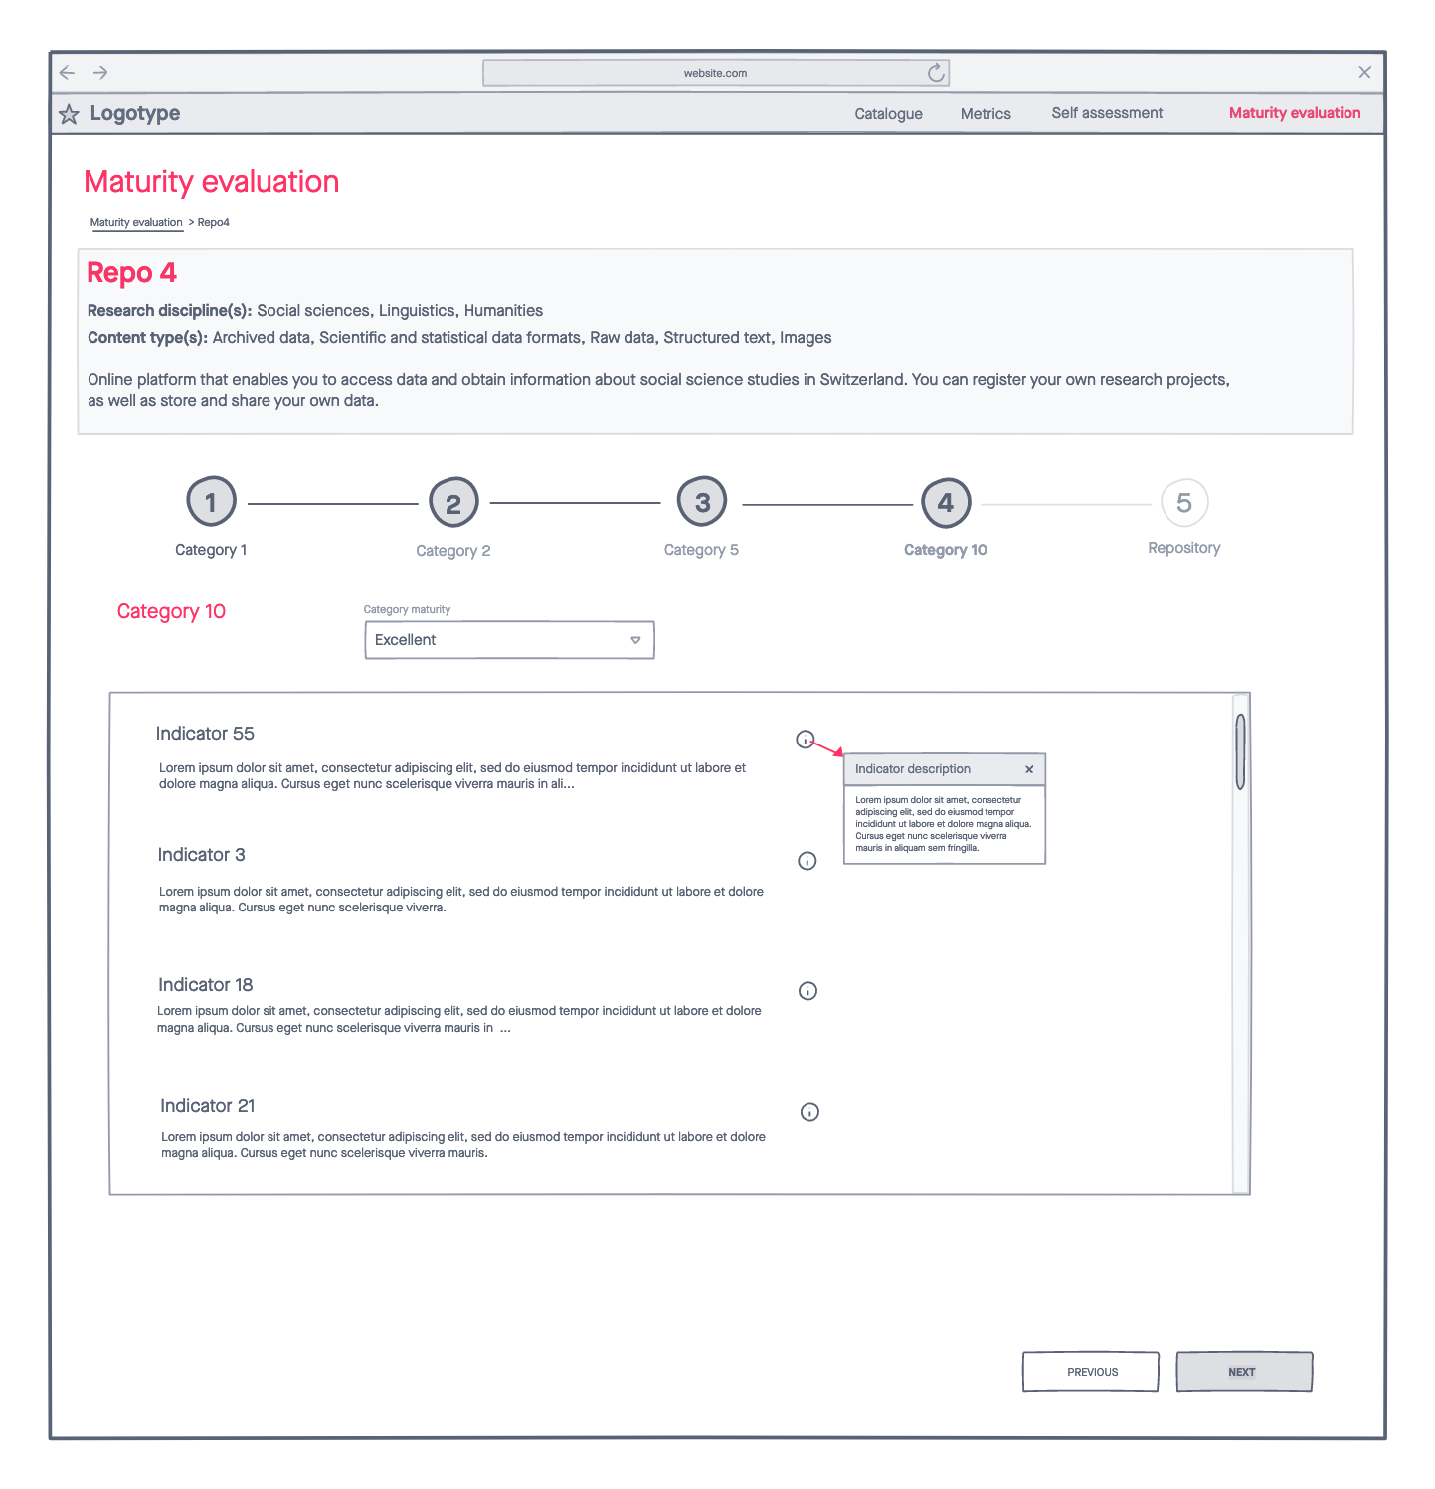
Mockups: Maturity evaluation – Step 5

Slide 17
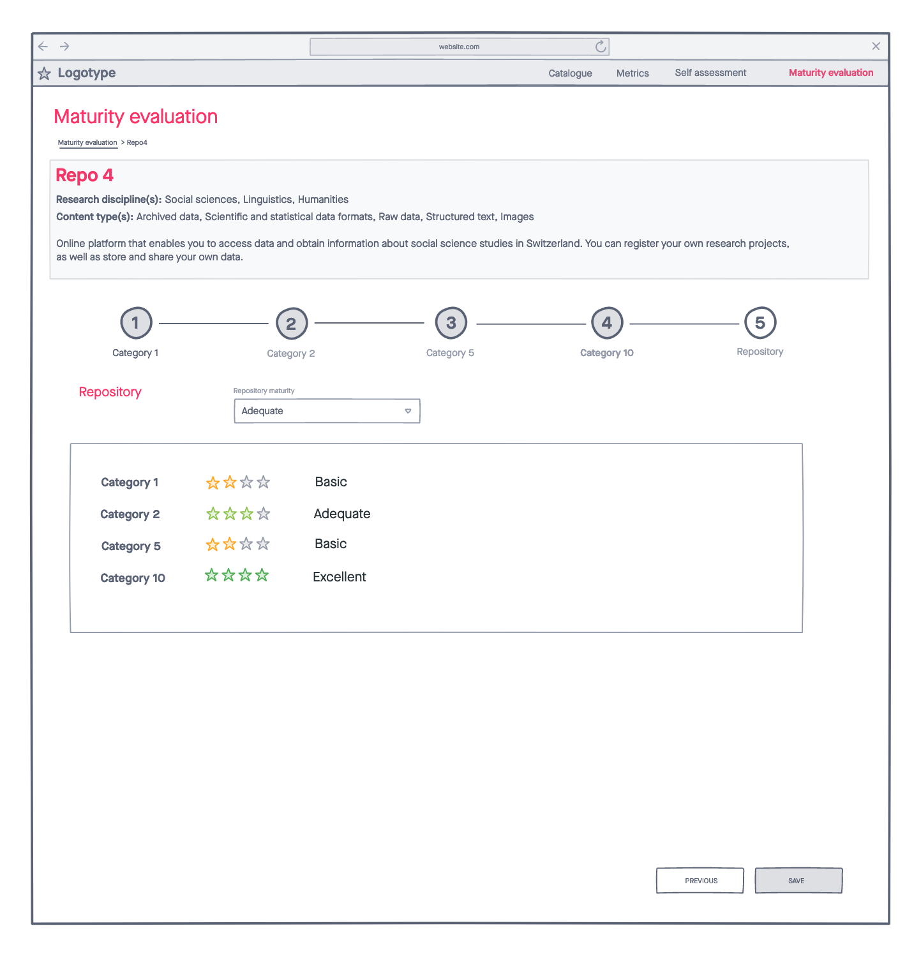
Mockups: Maturity evaluation – Final step

Slide 18
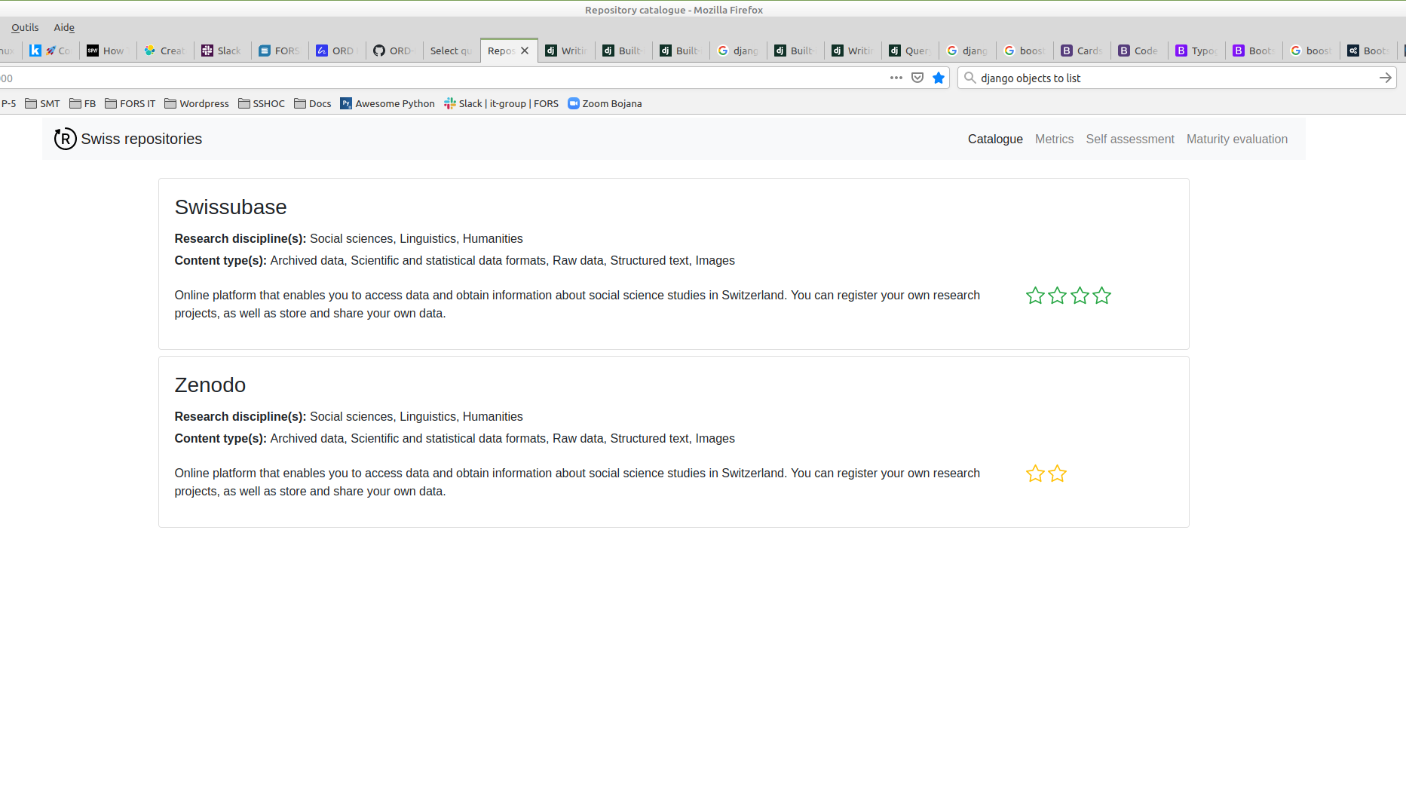
Demo

Slide 19
Findings
Discipline specific metrics
Compliance with the EOSC
recently published recommendations of the European Open Science Cloud ([EOSC](https://www.eosc-portal.eu/about/eosc)):
Recommendations on certifying services required to enable FAIR within EOSC (https://doi.org/10.2777/127253)
Recommendations on FAIR metrics for EOSC Data service professionals (https://doi.org/10.2777/70791 )
Group of experts

Slide 20
Future…
Finish the implementation of the prototype
Finalise list of indicators, compliant with the EOSC
Finalise the documentation
Approach The Open Science Delegation (DelOS)

Slide 21
More…
https://github.com/ORD-Hackathon/hackathon-2021/tree/swiss-repositories

Slide 22
Contact us
via email
rita.gautschy@dasch.swiss, guillaume.lefebvre@fors.unil.ch, daniela.subotic@dasch.swiss, bojana.tasic@fors.unil.ch
via slack
@Rita Gautschy , @Guillaume Lefebvre, @Daniela Subotic , @Bojana Tasic

